Slide 1

Exceptions and Out of Scope processes
Compliance Norm management
TRM – Governance office
16/02/2022

Slide 2
AGENDA
1
How to request an exception
1.1 Zoom on EP tool
1.2 Zoom on CRMS
2
How to request a re-application of an existing exception
2.1 Zoom on CRMS
3
How to notify on an Out of Scope
3.1 Zoom on CRMS
4
How to declare a Conjunctural Delay Monitoring
4.1 Zoom on CRMS

Slide 3
1
How do I request an exception

Slide 4







1. How do I request an exception
1st request
Formalize the request
(EP tool – CPL entity)
Review the request, validate or refuse
(EP tool – Norm owner)
Fill in request form
(CPL entity)
Validation
Structural Exception
Send request to entity of the Norm Owner
(EP tool – CPL entity)
If validated, feed information into CRMS
(CPL entity)
Check the need for an Exception
(LoD1/CPL entity)
Inform intermediate levels of the request
(EP tool/email - CPL entity)
Always
Optional
Conditioned

Slide 5

1. How do I request an exception?
Check the need for an Exception
Fill in the request form
An exception request is defined as a request, for a given period and subject to conditions, to apply a less stringent framework or less stringent controls than the standards established in a Norm.
The Norm Owner should seek to keep exceptions to a minimum by identifying such possibilities during the Scoping and Consultation phases of the Norm and by addressing them in advance within the Norm itself. Nonetheless, it is possible that the need for an exception might be identified after a Norm has been implemented.
If a request to not apply specific or full provisions of a Norm for an indefinite period of time (e.g. when the Group requires a specific threshold for reporting, but the local regulation specifies a different one), an exception will be needed
If an exception is needed, the procedures manager and procedure owner of the entity requesting the exception must document the exception request using the standard template which will be provided as an associated document to the CCC0016 procedure and soon available in the Governance Office SharePoint (link).
The rationale for the request should describe the current control environment associated with the Norm, the exact provision from which the exception is sought, any relevant compensating controls, and an assessment of any residual risk.
The maximum life period of an exception is 36 months by default.
See slides 8, 9 and 10 for a more detailed view on this part of the process

Slide 6

1. How do I request an exception?
Inform intermediate levels of the request - Optional
Formalize the request form and send request to entity of the Norm owner
Inform Business Lines and/or Proximity Perimeters, Regions of the request.
If necessary, the Business Lines, Regions and/or Territories may consolidate all exception requests and consult other Legal Entities that could be in the same position.
Business Lines, Regions and/or Territories have the possibility to propose, or impose, a consolidation at their own level before the exception request reaches the entity of the highest level parent Norm.
The entity requesting an exception should formalize it by using the EP tool (link) and address it to the entity of the Norm Owner of the highest level parent.
See slides 8, 9 and 10 for a more detailed view on this part of the process

Slide 7
1. How do I request an exception?
Review the request validate or refuse
If validated, feed information into CRMS - Conditioned
The Norm Owner of the highest level parent Norm (typically the Norm Owner of the related level 2 Norm) must review the rationale of the request and validate or reject the request or seek approval of the initial validation body. In case of significant impact to the Compliance Function or the Business, the Norm Owner must keep the initial validation body informed of his/her decision.
Note that the approval of an exception request will normally trigger the need for a transposition into a child Norm. This decision is at the discretion of the entity to which the exception applies.
If validated, the entity who requested the exception is responsible to feed CRMS with the granted exception.
The Norm Owner of the highest level parent Norm and the management of the entity requesting the exception must maintain an audit trail of all approved exception requests and must ensure that there are no overdue exception requests (i.e. exceptions for which the period of validity has expired).
At least annually, the Norm Owner of the highest level parent Norm shall perform a review of the validity of all approved exception requests and shall reconcile this with the management of the entities which requested the exceptions.
See slides 11 and 12 for a more detailed view on this part of the process

Slide 8
1.1 Zoom on EP tool – Exception request process (1/3)
Exception request
REQUESTER
(AU/BL/PP/REGION)
Home screen
‘Create File’
Header Screen
Enter Synthesis data
COMPLETE NECESSSARY TABS
DOMAIN/ENABLER
‘Exceptions’ tab
Download Exception form template
‘US Nexus’ tab
Answer ‘No’ to US Nexus question
‘‘Request for decision’ tab
Populate necessary information
Escalate/Route to norm owner
(Request)
Investigate
Validates or rejects
1
2
3
Escalate/Route to Intermediate level (Request)
Populate form
INTERMEDIATE LEVEL
(BL / REGION)
Attach Document
‘Internal for XX organization’ tab
Communicate internally with users within your entity (if needed)
‘Request for decision’ tab
Investigate file
and give a position
Escalate/Route to norm owner (Request)
Mandatory path
Optional path

Slide 9
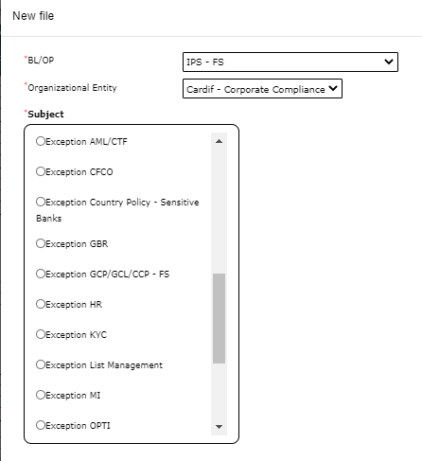
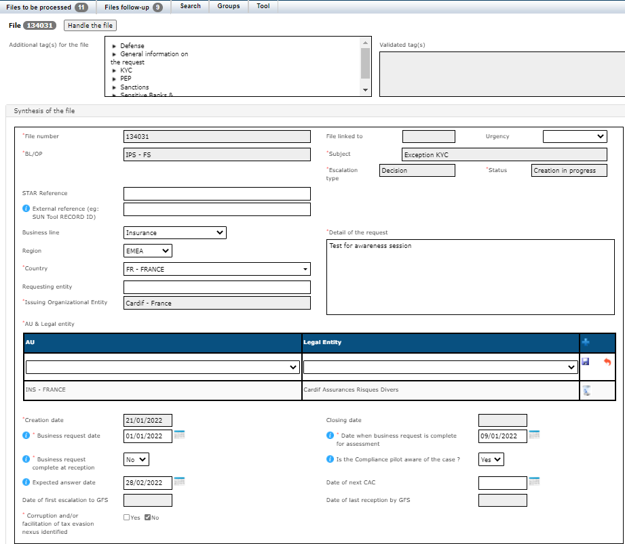
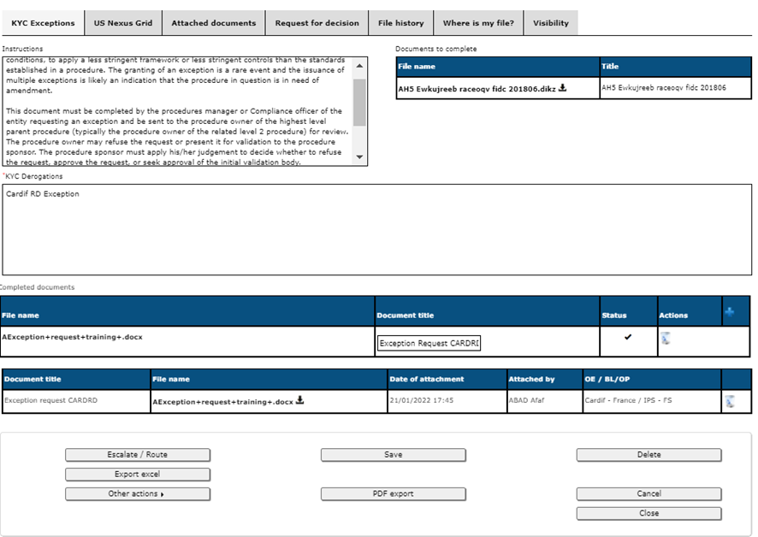
1.1 Zoom on EP tool – Exception request process (2/3)
1
Home screen
Select the Exception from a drop down menu
3
Synthesis tabs
Download Exception form
Upload the final document
Populate:
‘US Nexus Grid’ tab
‘Internal for XX organization’ tab (optional)
2
Header screen
Populate necessary fields

Slide 10
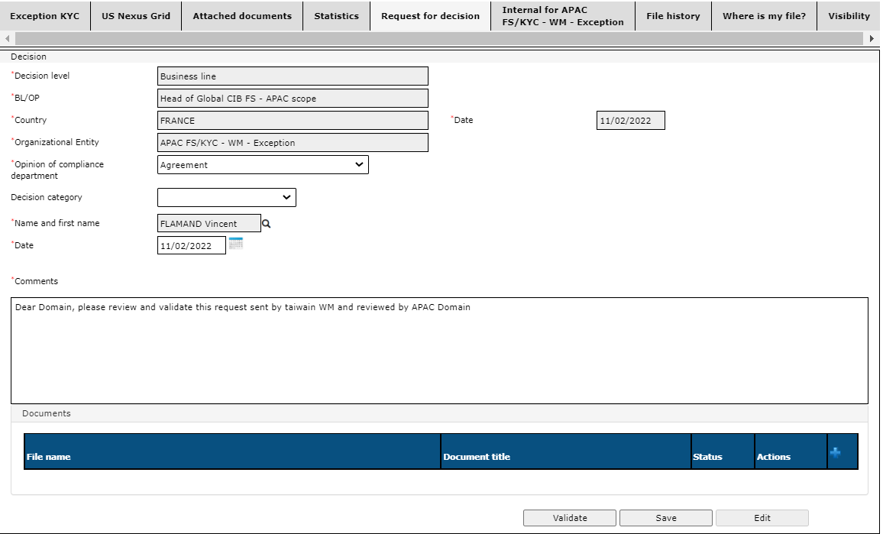
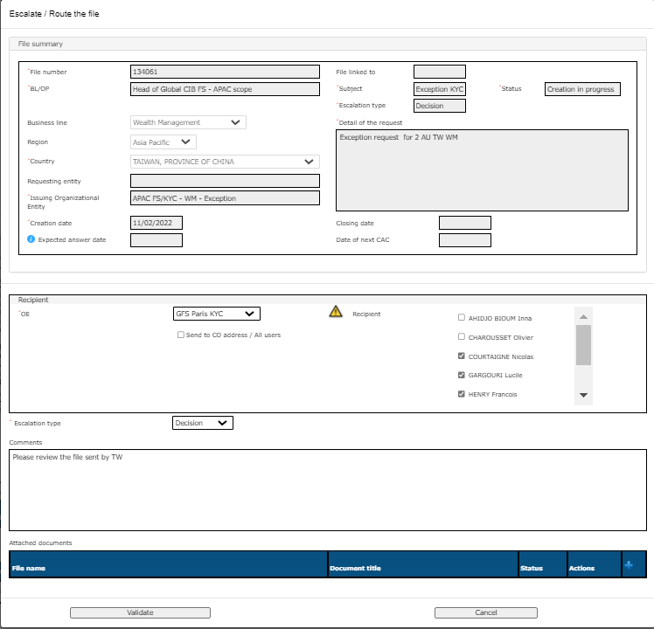
1.1 Zoom on EP tool – Exception request process (3/3)
4
Optional: ‘Request for decision’ tab
Escalate it to Intermediary body
(NB: each level escalated can give its own position
5
Mandatory: ‘Request for decision’ tab
Escalate the request to the Domain
(NB: Possibility to ‘deselect’ members of the recipients within the Domain)

Slide 11

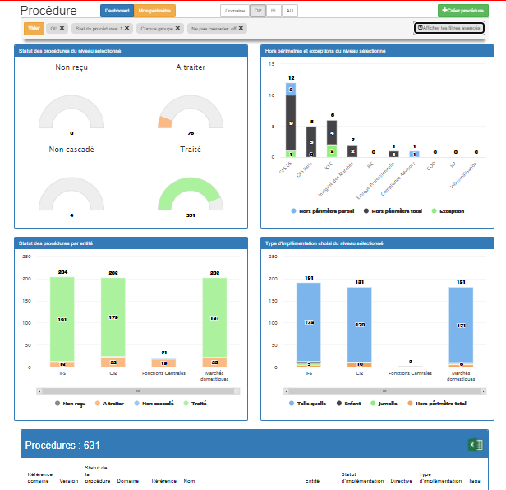
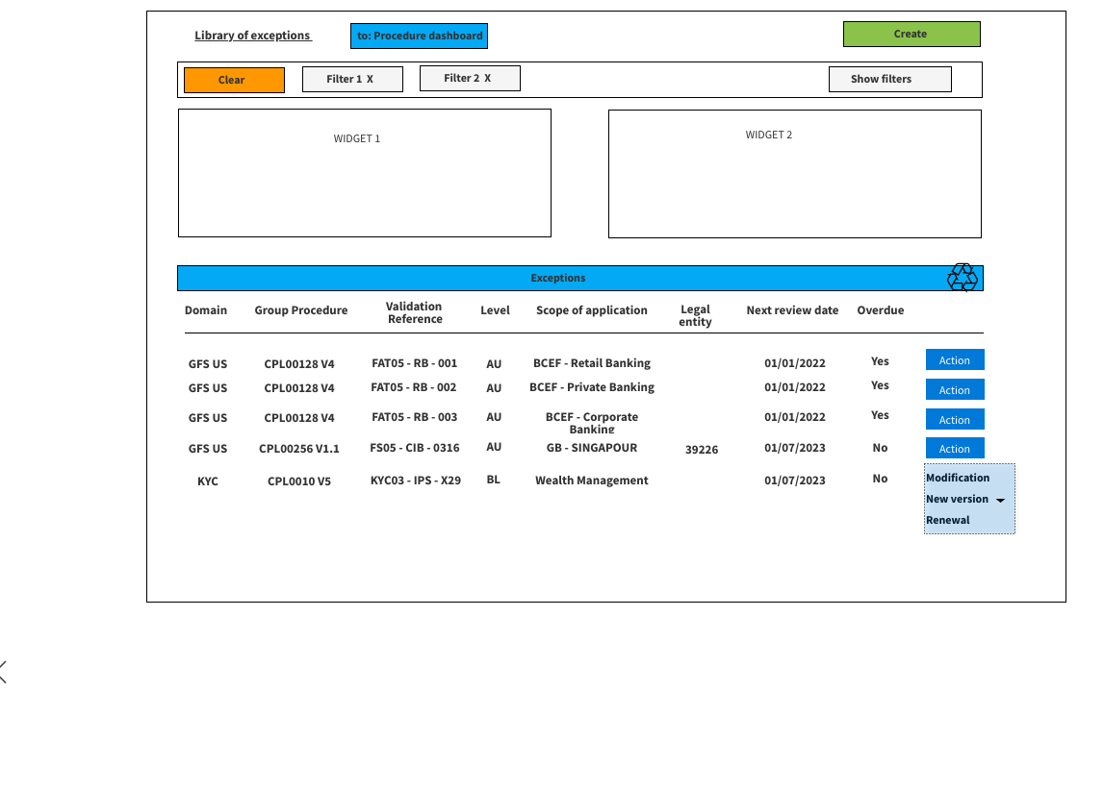
1.2 Zoom on CRMS – Library of Exceptions and Out of Scope (1/2)
Dashboard view
Library of Exceptions and Out of Scope as a mirror of the Procedures dashboard
Library of exceptions & OOS

Slide 12
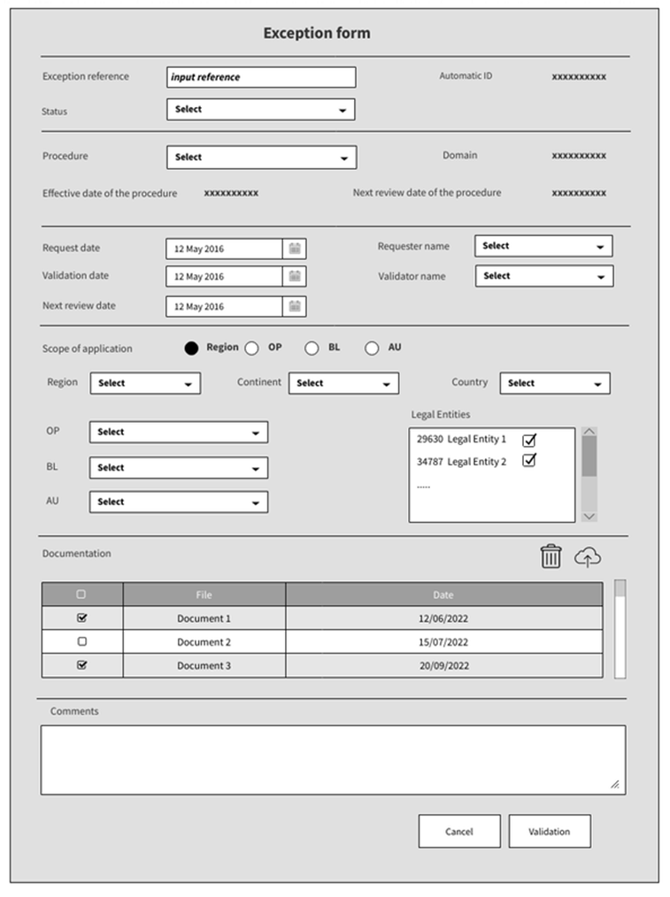

1.2 Zoom on CRMS – Library of Exceptions and Out of Scope (2/2)
Exception ID card
Exception ID card
Exception reference: Reference given by EP at the time of the validation
Status: Status of the ID car (e.g. created; draft)
Norm: Reference of the Norm where the exception is being requested (e.g. CPL0233, CCC0016, etc.)
Domain:
Effective date: Date that the procedure comes into force
Next review date: Date that the procedure will be reviewed
Request date: When the request was sent in EP
Validation date: When was the Exception validated in EP
Next review date: When should the exception be reviewed
Requester: Team that issued the request
Validator: Team that validated the request
Scope of application:
Documentation: Exception form to be attached
Please note that the ‘Region’ scope is still under discussion and there may be modifications to this document

Slide 13
2
How do I request a re-application of an existing exception

Slide 14
2. How do I request a re-application of an existing exception
Identify if previously granted exceptions will remain the same
(CPL entity)
If validated, feed information into CRMS
(CRMS – BL or Region)
Re-application of a Structural Exception
Re-validation
(if needed)
Send the request to BL or Region for validation
(Email – CPL entity)
Always
Optional
Conditioned

Slide 15
2. How do I request a re-application of an existing exception?
Identify if previously granted exceptions will remain the same
Send the request to Business Line or Region for validation
When a Norm is updated and the portion that was the subject to a validated Structural Exception has not been updated, or the Exception becomes overdue a reapplication is allowed.
The maximum period after which any exception must be re-submitted for approval is 36 months by default, unless a shorter review period is required by local regulations, or unless the procedure itself is reviewed during this time.
Reapplications are managed at Business Line, Proximity Perimeters or Region level, by the respective expert of the entity.
Business lines will manage Assessment Units requests
Proximity Perimeters will manage Business lines requests
Domains will manage Proximity Perimeters requests

Slide 16
2. How do I request a re-application of an existing exception?
Register the validation in CRMS - Conditioned
The entity entitled to validate the reapplication should do so by registering the answer in CRMS. Or refuse it by archiving the ID card.
Additionally, the validator should inform other levels of the reapplication i.e. Domain, Proximity Perimeters and/or Regions.
See next slide for a more detailed view on this part of the process

Slide 17
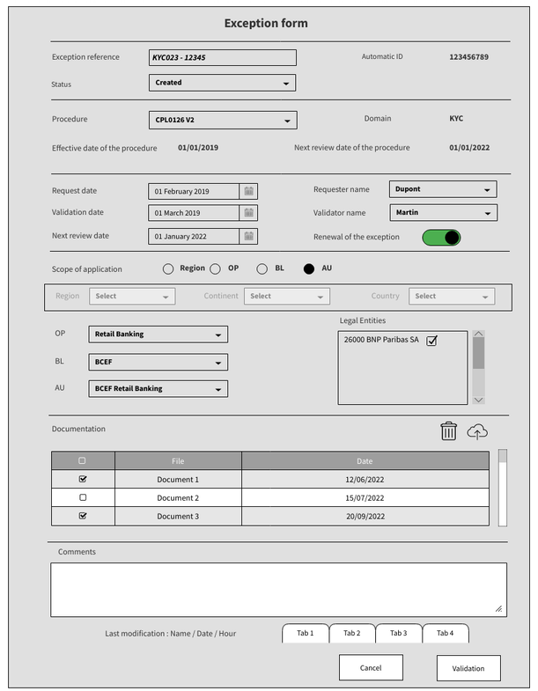

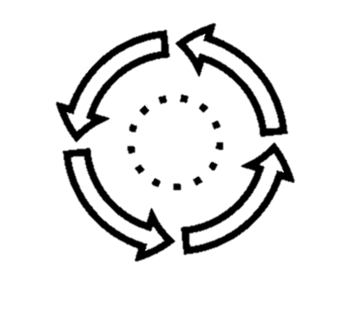
2.1 Zoom on CRMS – Library of Exceptions and Out of Scope (1/1)
Re-application of an Exception
Re-application of Exceptions process
Dashboard will flag exceptions which are overdue and the exceptions for which a new version of the norm is created
The action button is activated depending on the role of the user
Activation rule :
Button « Renewal» is activated for Domain admin in case the exception is « PP level »
Button « Renewal» is activated for Proximity Perimeters administrators in case the exception is « BL level »
Button « Renewal» is activated for Business Line admin in case the exception is « AU level »
Next review date is not manually modifiable
The historic of the modifications are displayed in the tabs at the bottem of the ID card
Fields that will change on the re-validation by upper level :
Tick the box to confirm the renewal
Next review date will be automatically updated according to the timeframe given by the Domain (e.g. If the Domain validated an Exception requested by an AU for a year, the exception will be re-validated by the BL for one more year)
No other modification is allowed except for comments
Please note that the ‘Region’ scope is still under discussion and there may be modifications to this document

Slide 18
3
How do I notify on an Out of Scope

Slide 19
3. How do I notify on an Out of Scope
Formalize the notification in CRMS
(EP tool – CPL entity)
Fill in notification form
(CPL entity)
Out of Scope notification
Check the need for an Out of Scope
(LoD1/CPL entity)
Inform intermediate levels of the notification
(Email - CPL entity)
Always
Optional
Conditioned

Slide 20
3. How do I notify on an Out of Scope
Check the need for an Exception
Fill in the request form
If an entity or Business Line does not conduct the business or activity covered by a Norm, it is considered Out of Scope (‘OOS’) and the Norm is not applicable.
The Norm Owner should seek to keep Out of Scopes to a minimum by identifying such possibilities during the Scoping and Consultation phases of the Norm and by addressing them in advance within the Norm itself. Nonetheless, it is possible that the need for an Out of Scope might be identified after a Norm has been cascaded.
If an Out of Scope is needed, the procedures manager and procedure owner of the entity must document the Out of Scope request using the standard template which will be provided as an associated document to the CCC0016 procedure and soon available in the Governance Office SharePoint.

Slide 21
3. How do I notify on an Out of Scope
Inform intermediate levels of the request - Optional
Formalize the notification in CRMS
Inform Business Lines and/or Proximity Perimeters, Regions of the Out of Scope.
If necessary, the Business Lines, Regions and/or Territories may consolidate all Out of Scope requests and consult other Legal Entities that could be in the same position.
Business Lines, Regions and/or Territories have the possibility to propose, or impose, a consolidation at their own level before the Out of Scope reaches the entity of the highest level parent Norm.
The entity Out of Scope is responsible to feed CRMS with the necessary information and attach the filled form.
The Norm Owner of the highest-level parent Norm should regularly review all Out of Scope notifications published in CRMS, challenge them if necessary, and determine whether the Norm’s scope should be more clearly defined when the Norm is next up for review.
All forms must be stored for audit trail purposes by the Out of Scope entity and the Norm Owner of the parent Norm.
At least annually, the Norm Owner of the parent Norm shall review if the reasons justifying the notification are no longer valid.
See next slide for a more detailed view on this part of the process

Slide 22
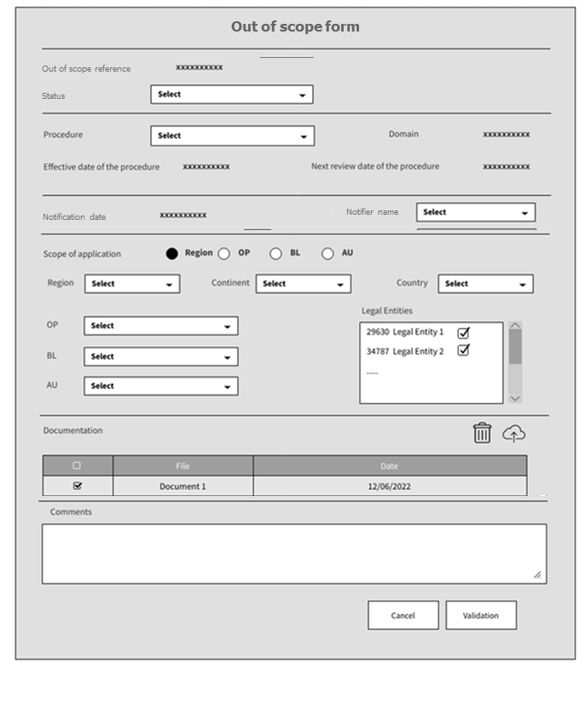
3.1 Zoom on CRMS – Library of Exceptions and Out of Scope (1/1)
Out of Scope
Out of Scope ID card
Out of Scope reference: Reference given automatically by CRMS
Status: Status of the ID car (e.g. created; draft)
Norm: Reference of the Norm for which the Out of Scope is being notified (e.g. CPL0233, CCC0016, etc.)
Domain: Domain owner of the norm mentioned on the previous field (automatically populated)
Effective date of the procedure: Date that the procedure comes into force (automatically populated)
Next review date of the norm: Date that the procedure will be reviewed (automatically populated)
Notification date: Date at which the ID card was populated (automatically populated)
Notifier name: Team that issued the ID card
Scope of application:
Documentation: Out of Scope form to be attached
Please note that partial out of scopes do not exist in the new framework
Please note that the ‘Region’ scope is still under discussion and there may be modifications to this document

Slide 23
4
How to declare a Conjunctural Delay Monitoring

Slide 24




4. How to declare a Conjunctural Delay Monitoring
Challenge delay and action plan
(CPL BL / Region or PP)
Record delay and action plan (CRMS)
(BL CPL)
Monitor Mitigation plan
(PP / Region / CPL Domain)
Extract (TRM-GO)
Document delay and mitigation plan
(LoD1 AU)
> 6 months (Initial)
> 6 months (overdue)
Conjunctural Delay Monitoring
< 6 months
Procedure implementation delay overdue
(LoD1 AU)
Challenge delay & action plan
(LoD1 AU / CPL BL)
Monitor Mitigation plan
(CPL BL)
Record delay and action plan in CRMS
(CPL AU)
Extract (TRM-GO)

Slide 25
4. How to declare a Conjunctural Delay Monitoring
Identify if the implementation deadline won’t be met
Formalize the delay in CRMS
In the event the LoD1 cannot meet the implementation deadline, as soon as possible before the deadline it should:
inform its Compliance Team of the issue and reasons for the delay,
have an Action Plan ready with a new deadline.
Based on the foregoing Action Plan, Business Line Compliance (when the remediation timeframe is 6 months or less) or PP Compliance (when the remediation timeframe is more than 6 months) shall:
check and challenge the proposed LoD1 Action Plan;
inform the Central Domain (and PP when less than 6 months)
monitor implementation status (‘Conjunctural Delay Monitoring’) through forums in place such as Internal Control Committees (ICC), Compliance Committees or the equivalent
When a conjunctural delay involves a Region rather than a PP, any delays, whatever the length, are managed at the level of Region which informs the Central Domain.
The entity entitled to inform the Central level should do so by populating the necessary information in CRMS (link).
See next slide for a more detailed view on this part of the process

Slide 26
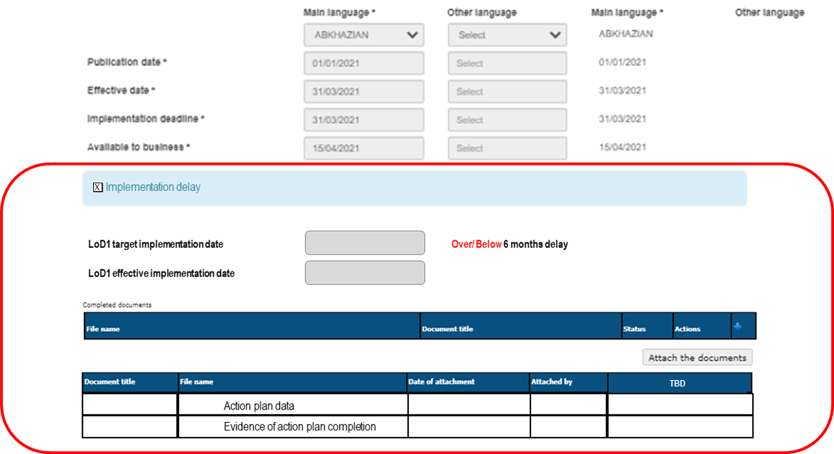
4.1 Zoom on CRMS – Conjunctural delay monitoring

